Slide 1
How to find your PAWS

Slide 2
Log into the Ohio Department of DD then Click the little person in the upper right corner. Log into your account.

Slide 3
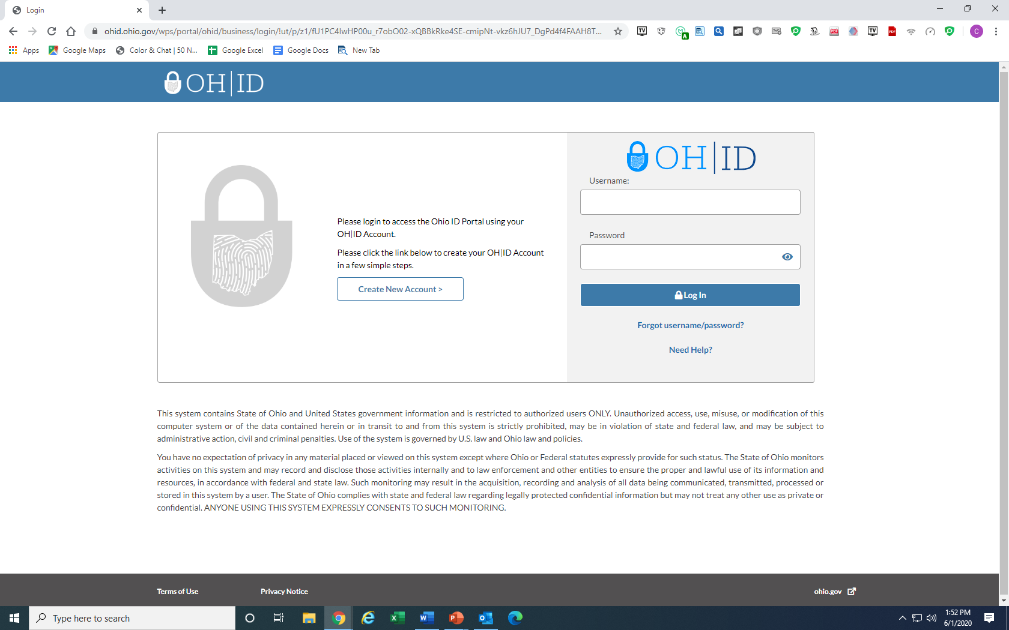
Enter Username and Password

Slide 4
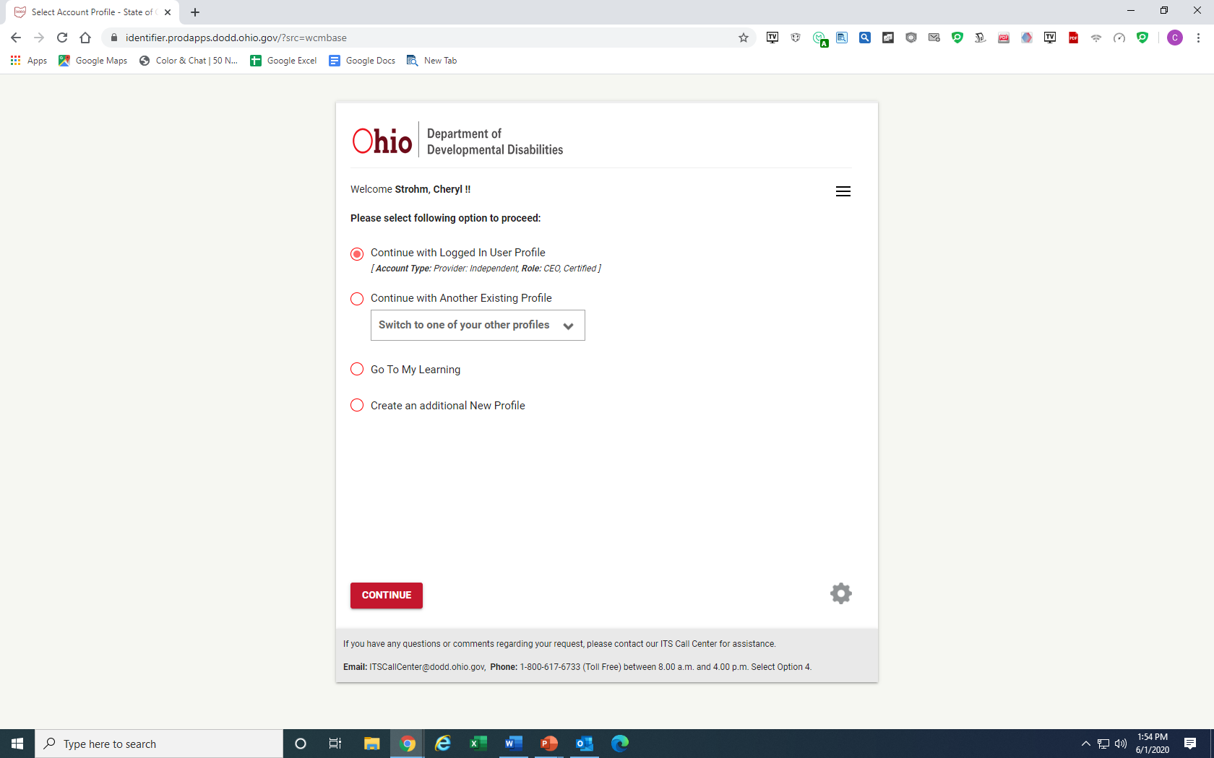
If everything is correct on the screen click continue.

Slide 5
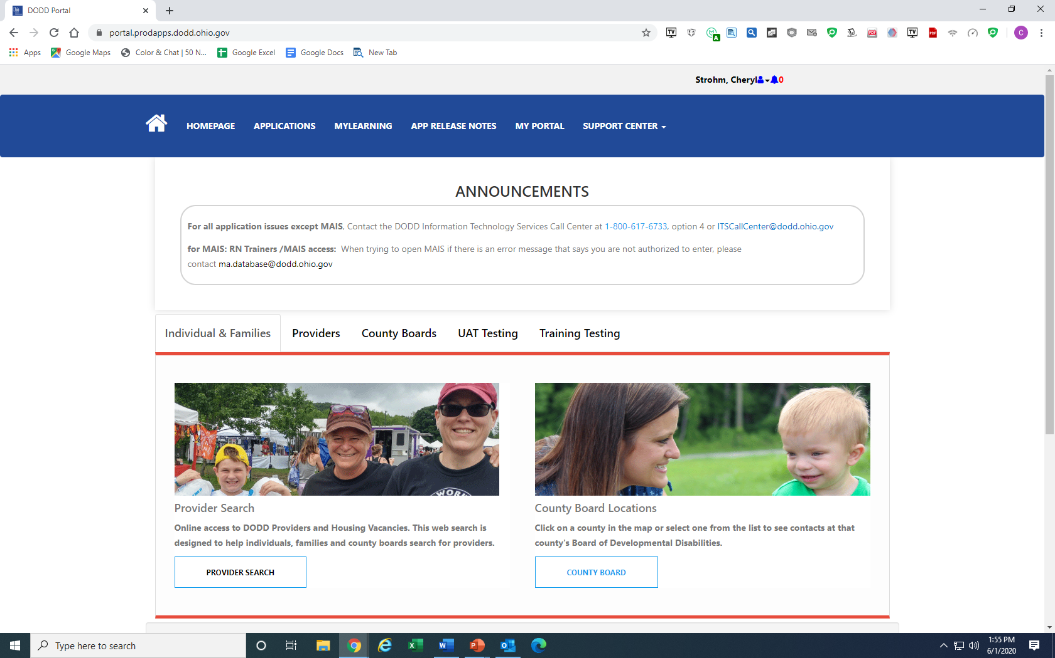
Click Application

Slide 6
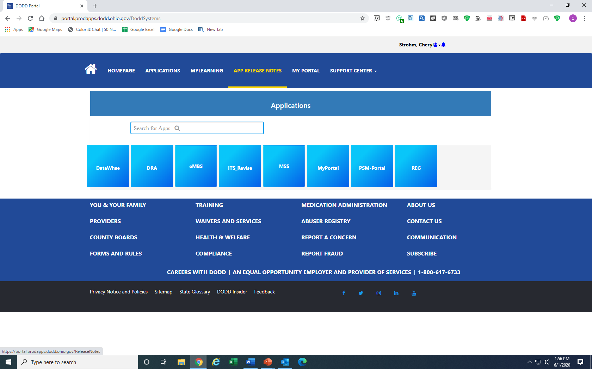
Click the MSS button.

Slide 7
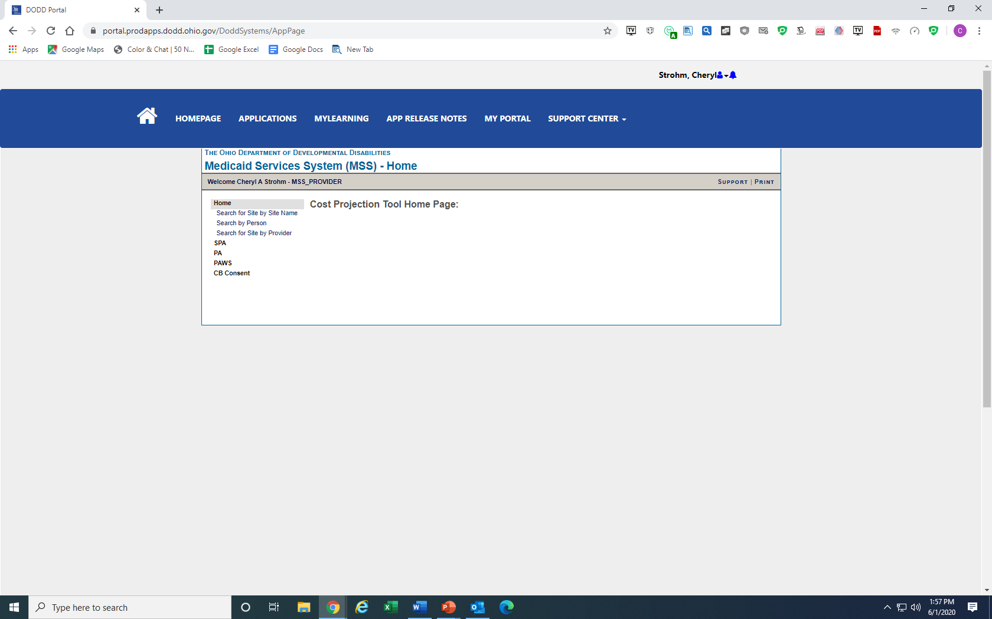
Click Search by person

Slide 8
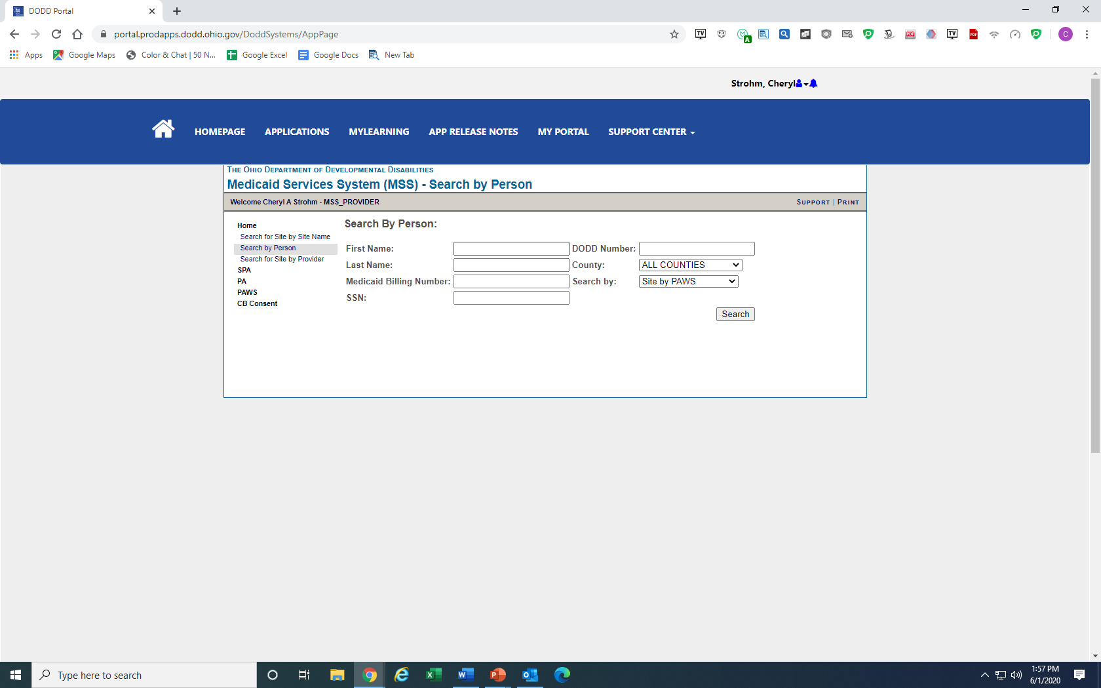
Put first name and then last name then the county, then click search.

Slide 9
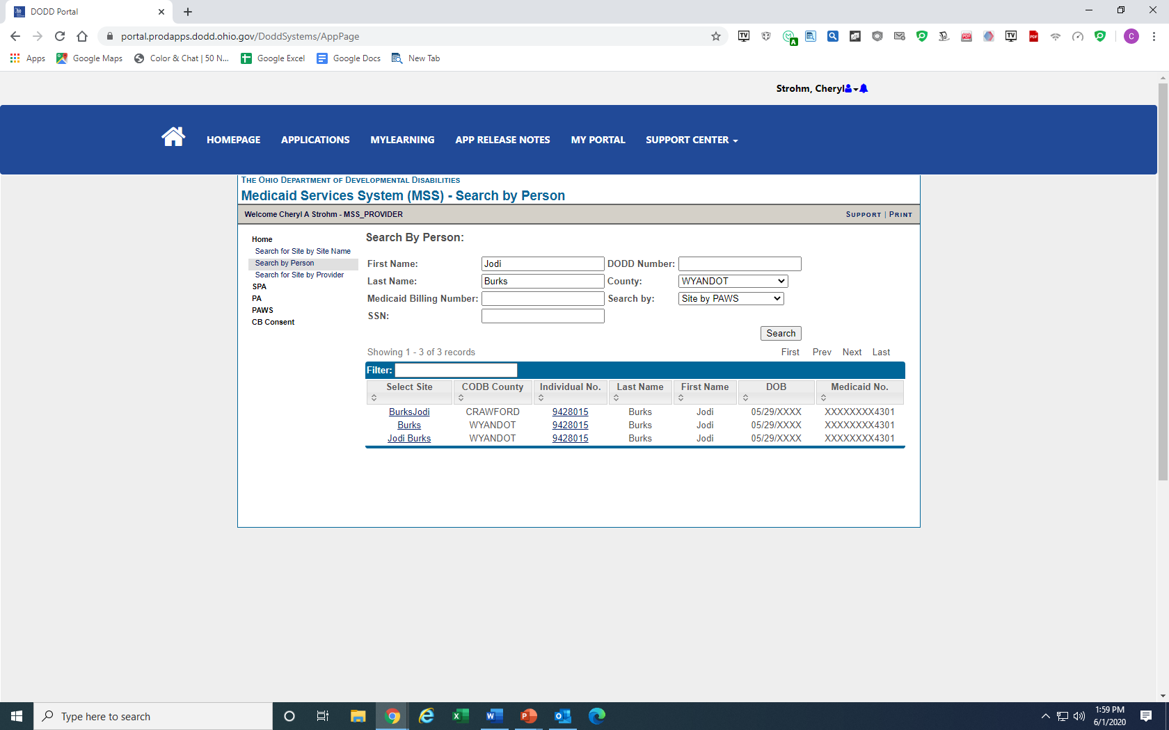
Click County you are searching.

Slide 10
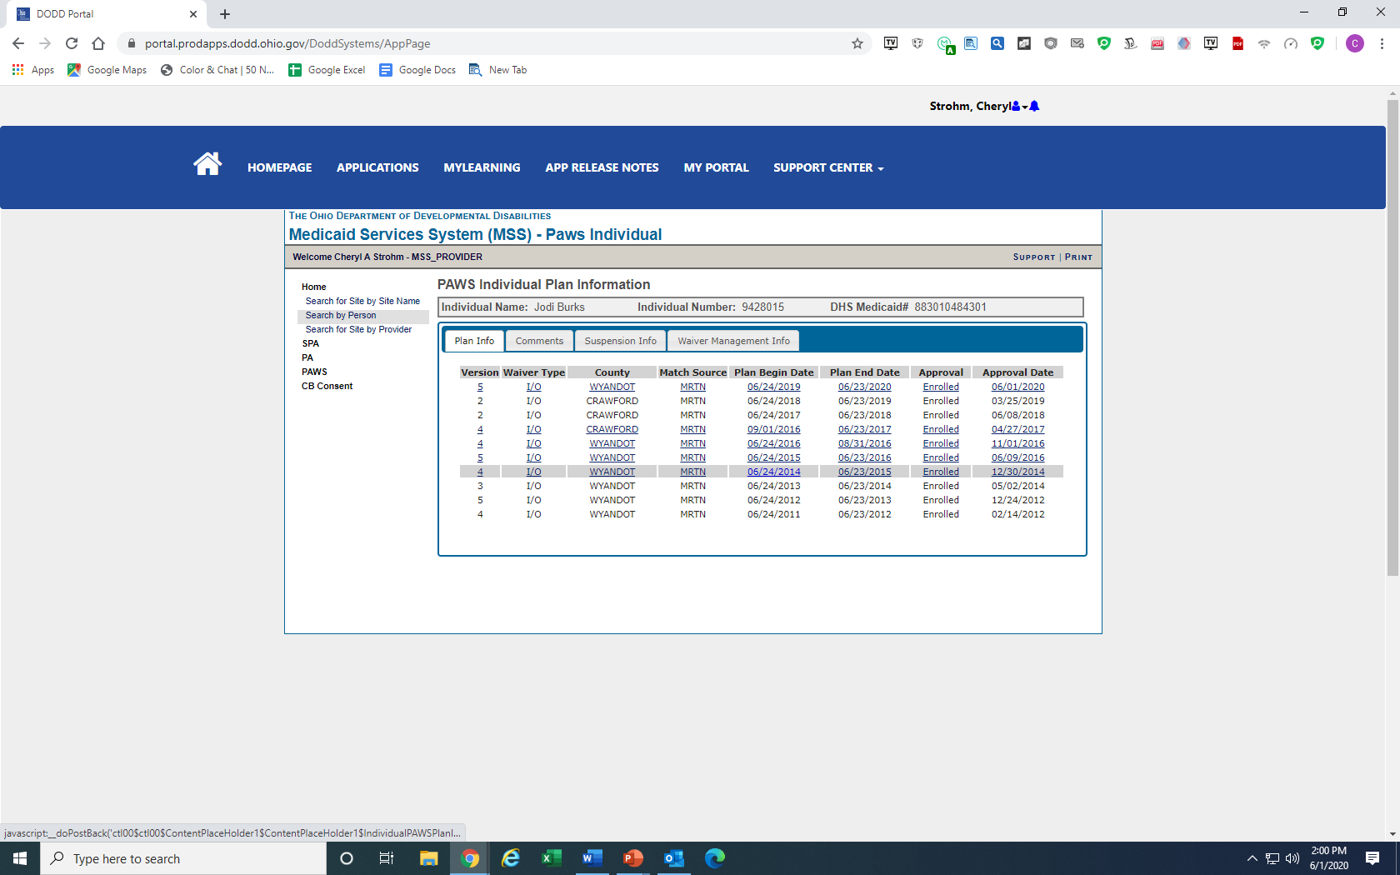
Click the most recent

Slide 11
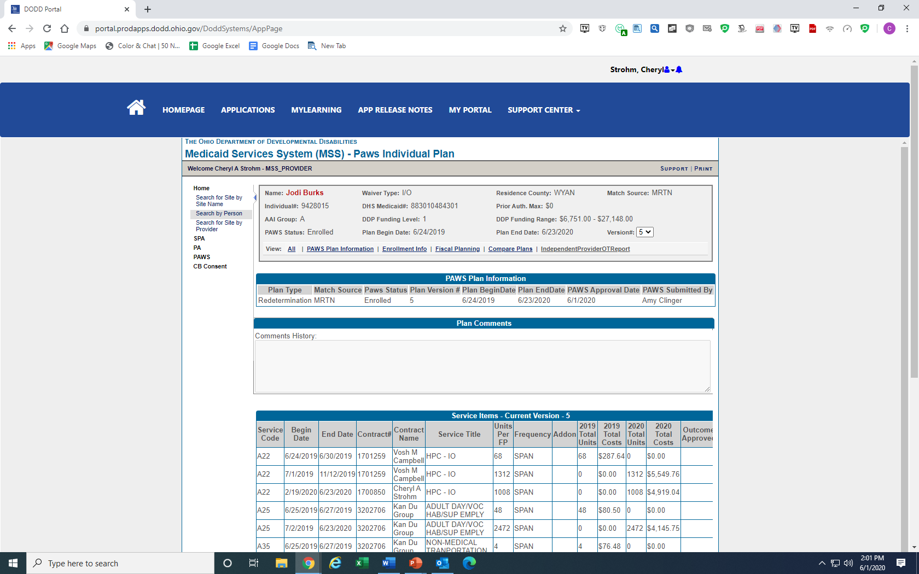
This is your PAWS

