Slide 1
How to Add on A Service

Slide 2
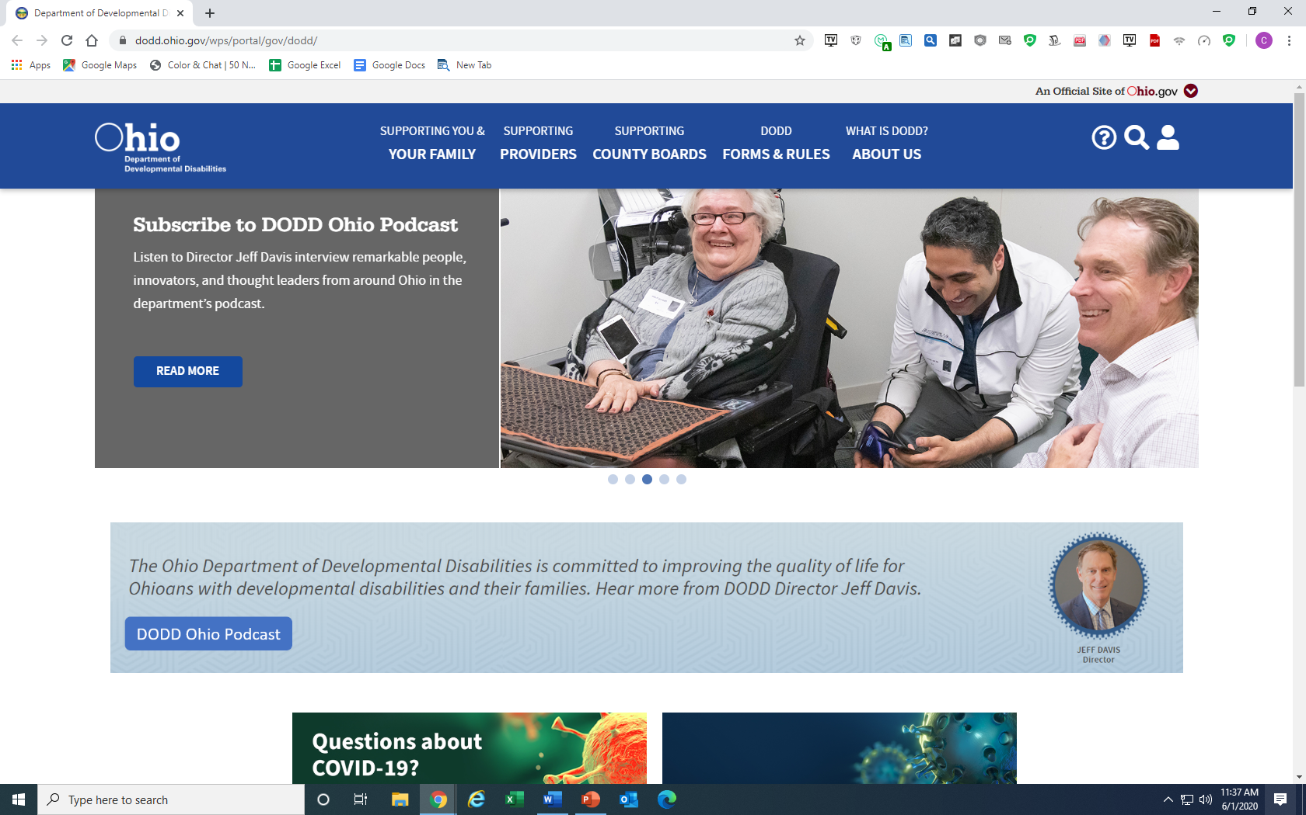
Log into the Ohio Department of DD then click the little person in the upper right corner. Log into your account.

Slide 3
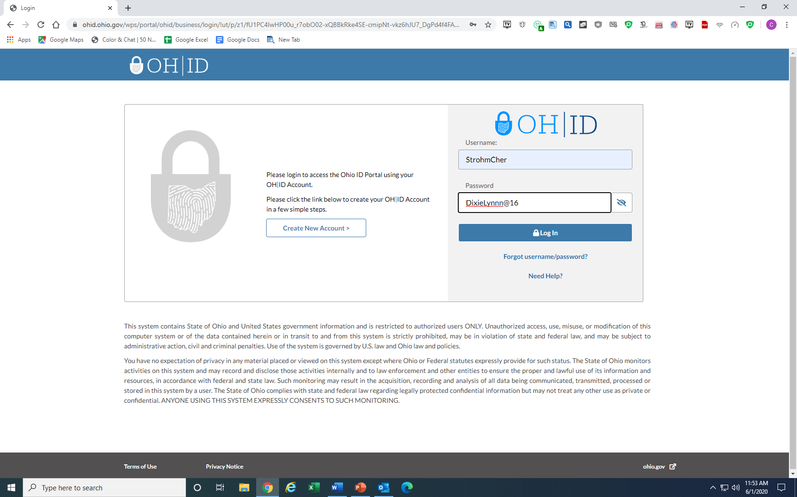
Enter Username and Password

Slide 4
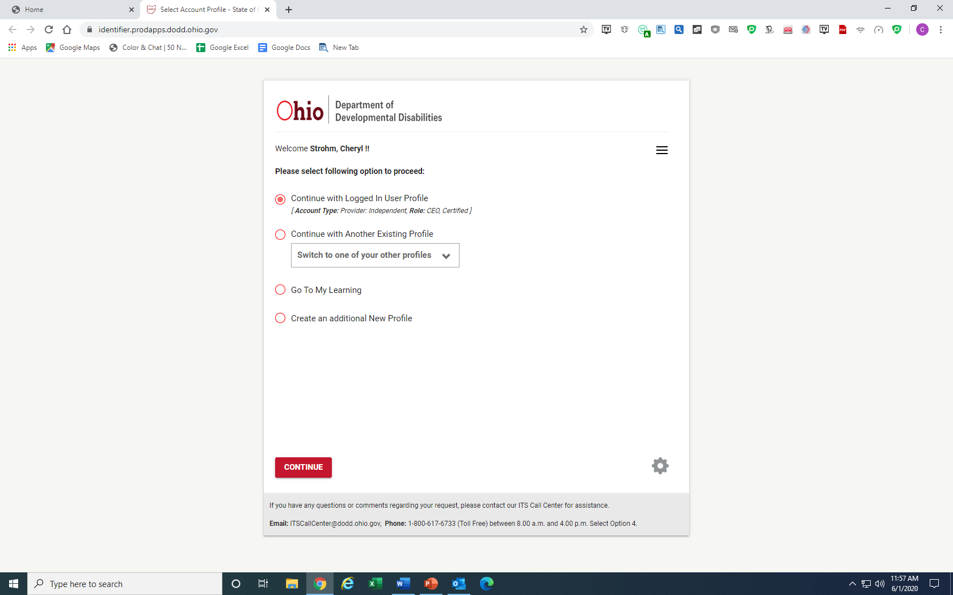
If everything is correct on screen click continue.

Slide 5
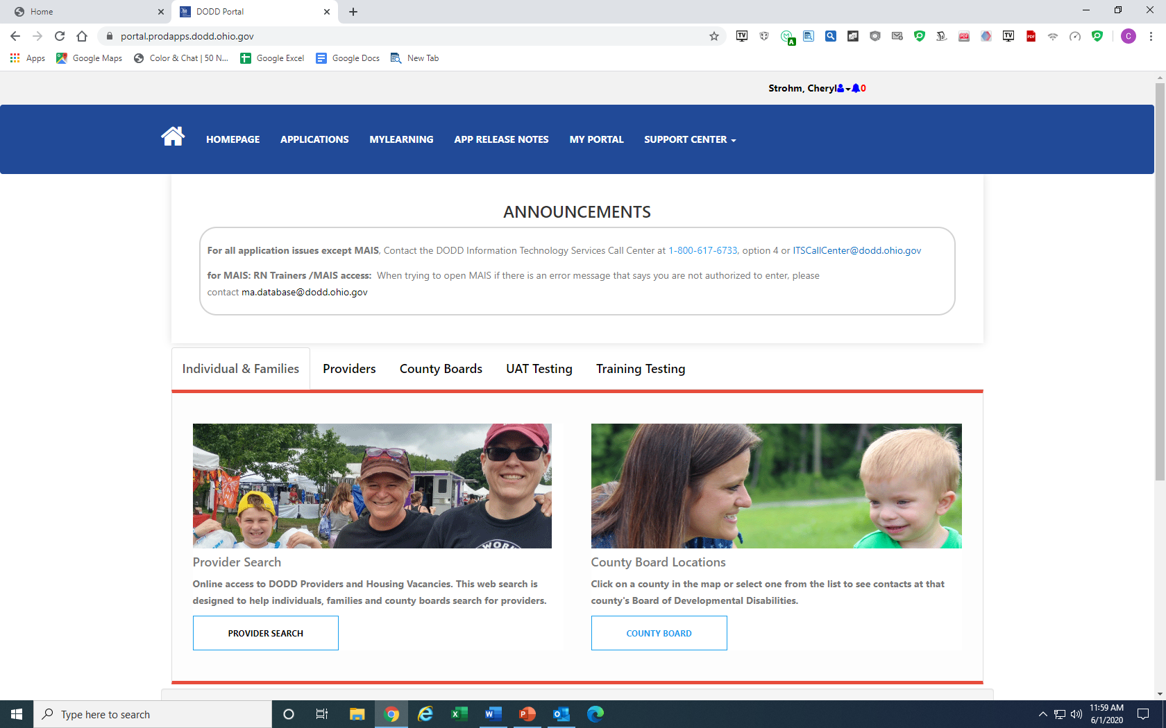
Click Application

Slide 6
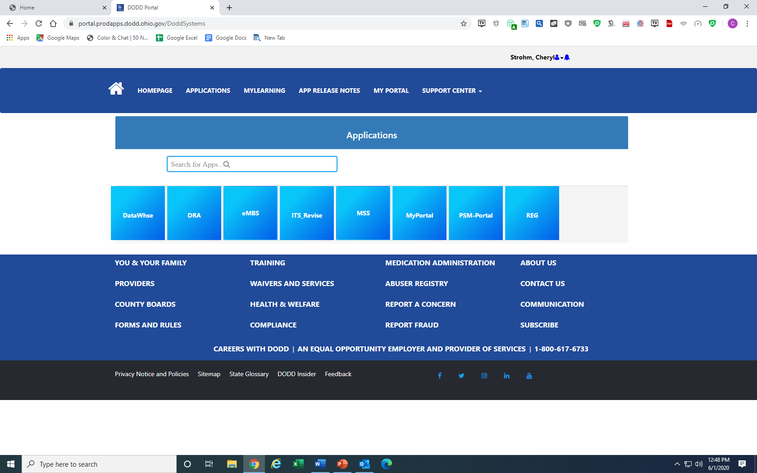
Click PSM-Portal

Slide 7
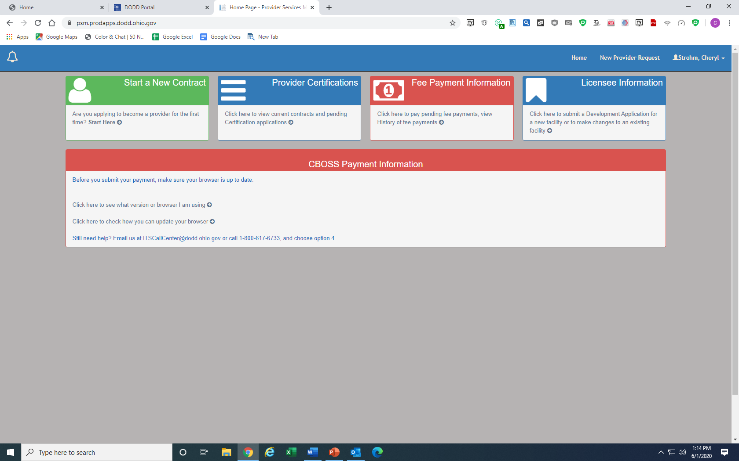
Click Arrow in the box of Provider Certifications

Slide 8
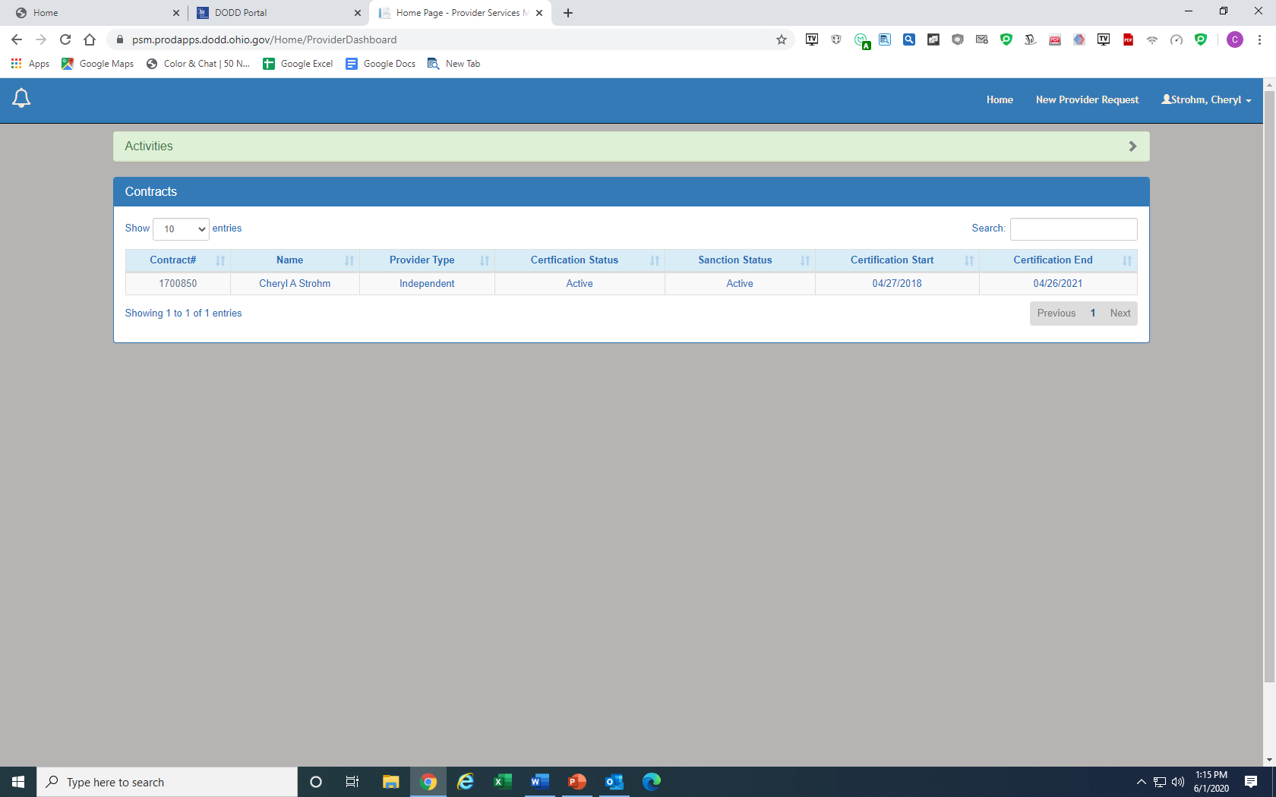
Click Contact Number

Slide 9
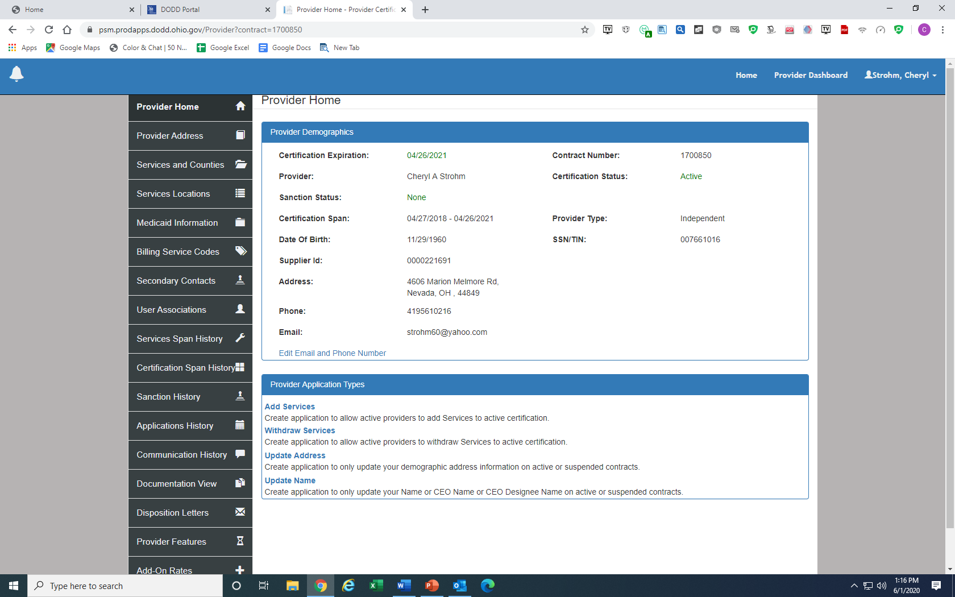
Click Add a Service

Slide 10
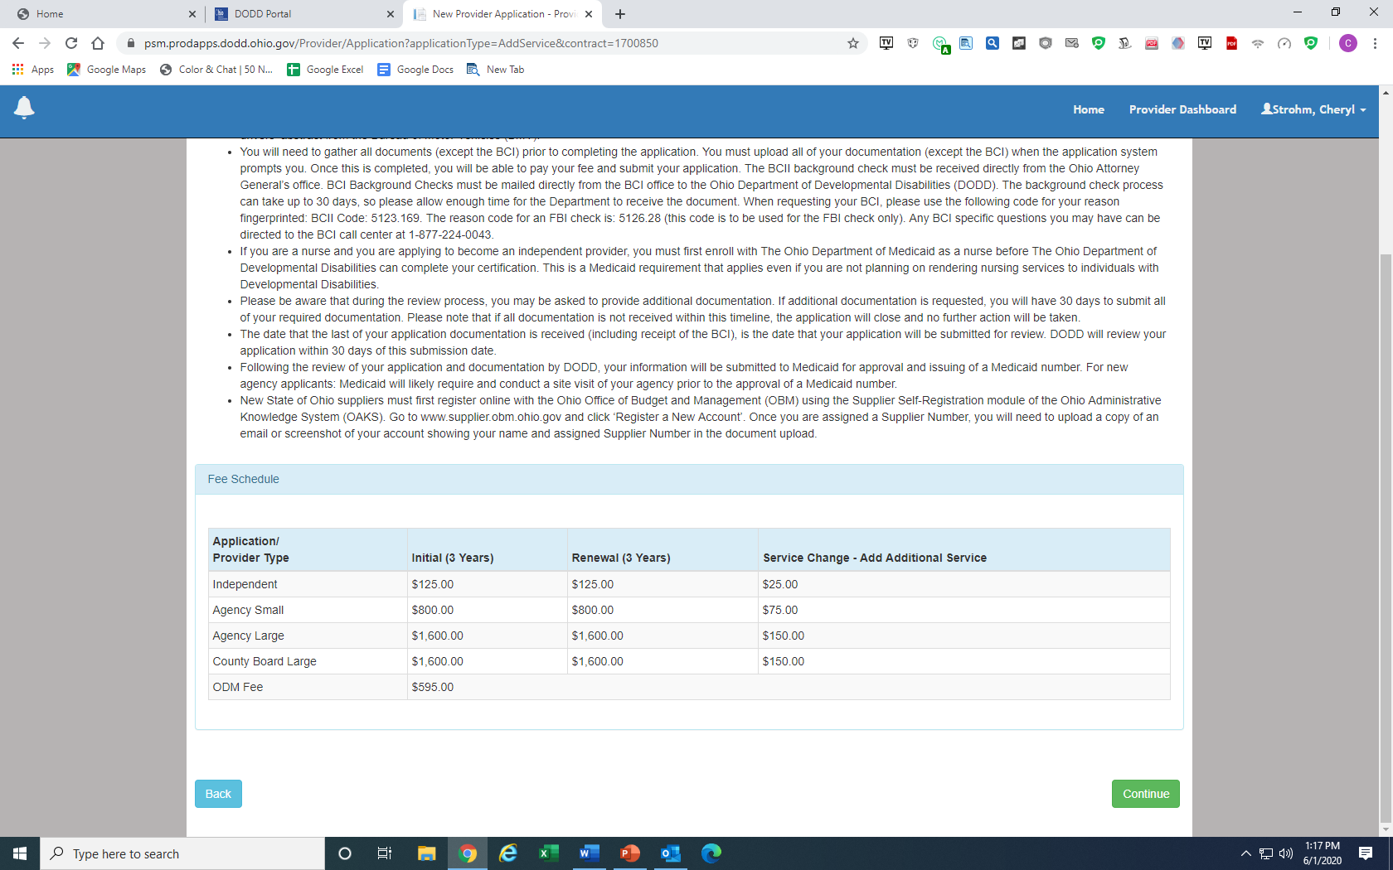
Click Continue

Slide 11
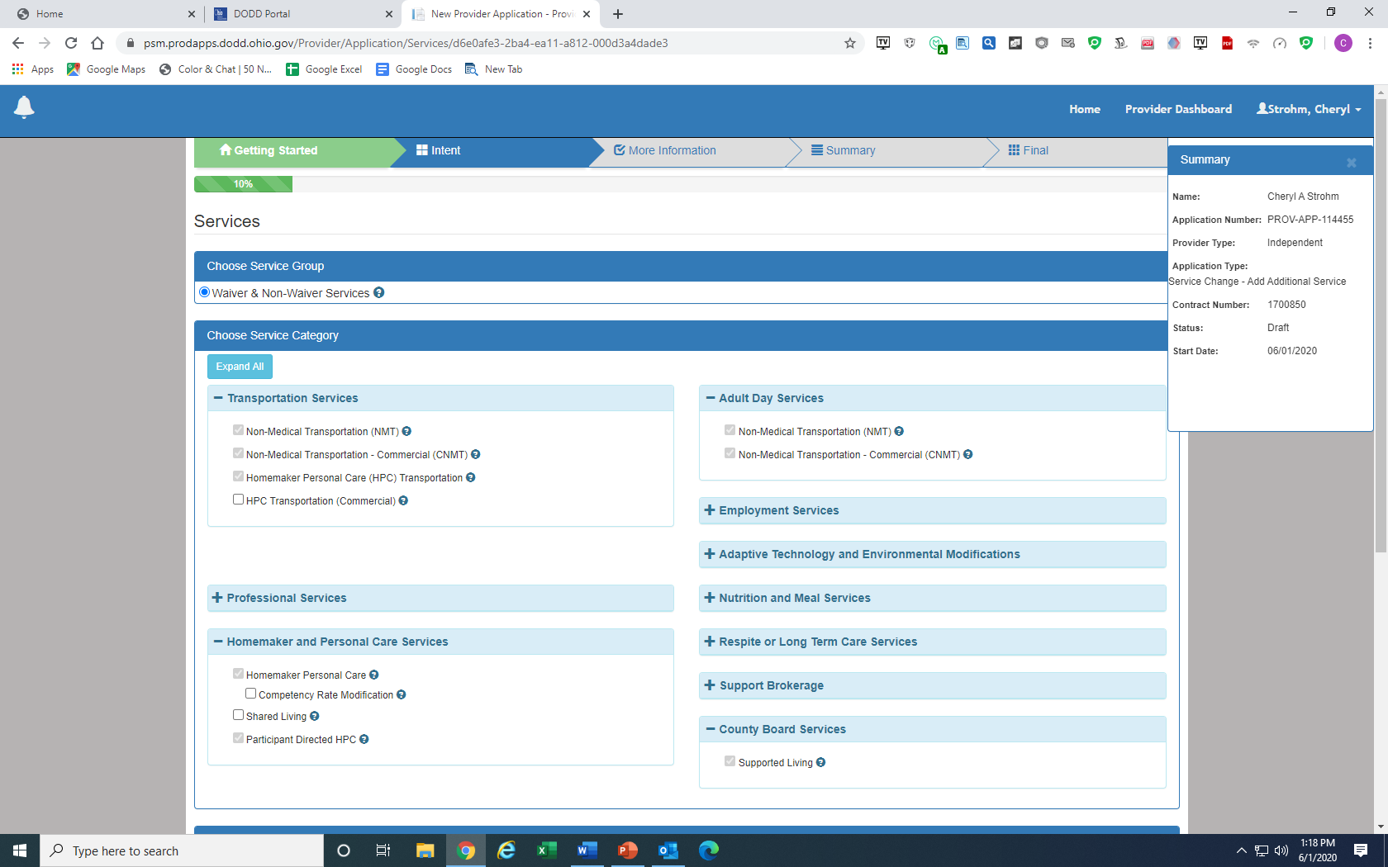
Click the Service that you would like to add on. If you have questions about the service, click the question mark beside the service it will have explanation.

